Slide 1
Data Science
General Assembly Lecture 1
Instructor: Hamed Hasheminia

Slide 2
Instructional Team:
Hamed Hasheminia
Karla Leibowitz
Joshua Cano

Slide 3








A little about me
Projects with substantial data science components that I have been involved with:
Insurance Corporation of British Columbia
WestJet
Transport of Canada
Logico Carbon Solutions
Prince Rupert Authorities

Slide 4
A little bit about yourself
Your Name
Summary of your background
What are you hoping/expecting to get out of this class
Some interesting factoid about yourself

Slide 5


GA Directory
The GA Directory is a place for students, alumni and instructors to connect.
Find your classmates
Reach out to alumni and instructors
Hire talent based on skills and experience
directory.generalassemb.ly

Slide 6
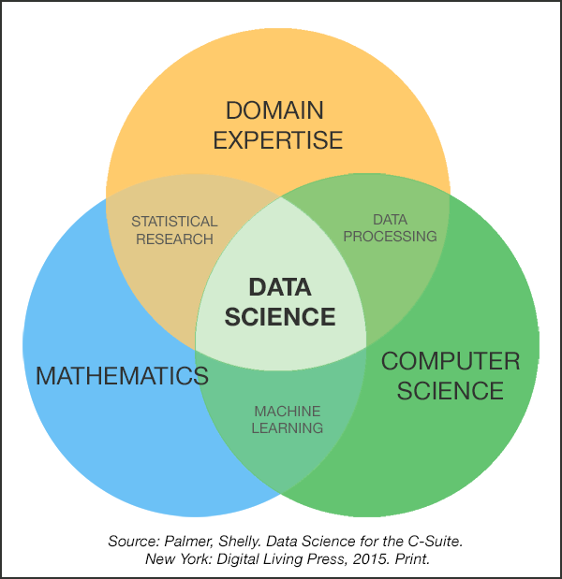
What is Data Science?

Slide 7
Instructor Philosophy
Adjustable pace
Interactive Class
Learn how to learn
Learn by teaching
Slow and constant progress

Slide 8
Content Philosophy
Learn by doing
In-Class examples
Assignments
Course Project
Practice, Practice, Practice
Extensive use of visuals
Balance of depth with breadth

Slide 9
How to succeed
You cannot drive by just sitting on the passenger seat
Ask questions
Answer questions
Teach to your classmates
You only learn something when you can teach it to somebody else.
Practice, Practice, Practice

Slide 10
Typical Class
Review of previous materials
Theoretical lecture – from PowerPoint slides
Lab / Code Walk-through
In-class exercises
Homework assigned

Slide 11
GA GRADUATION REQUIREMENTS
Homework (80% of Homework and Labs)
Attendance (Miss no more than 2 classes)
Final Project
a) Come up with 3 research ideas – due 3rd session
b) Create an outline for your project. What you want to test, what are your goals – due 7th session
c) Clean your data and do exploratory analysis (Due 12th session)
d) Detailed iPython technical notebook with your models (18th session)
e) Present your work (20 minutes presentations) (19th and 20th sessions)

Slide 12
Topics to be covered in the class
Introduction/Basic Stat (2 sessions)
Linear Models (2 sessions)
Model Selection and Regularization (1 session)
Missing Data and Imputation (1 session)
K-Nearest Neighbors (1 session)
Logistic Regression (2 sessions)
In class Team Project (1 session)
Decision Tree CART (1 session)
Bagging, Boosting, Random Forest (1 session)
Natural Language Processing (1 session)
Principal Component Analysis (1 session)
Time series Models (1 session)
Naïve Bayes (1 session)
Flex Session (to be decided)
Ensemble models and summary (1 session)
Project presentations (2 sessions)

Slide 13
Let’s get Started!
Agenda
Supervised – Unsupervised learning
Classification vs Regression
Flexibility vs Interpretability
Time series vs cross-sectional analysis
Parsing data / data dictionary
Intro to Numpy and Pandas

Slide 14
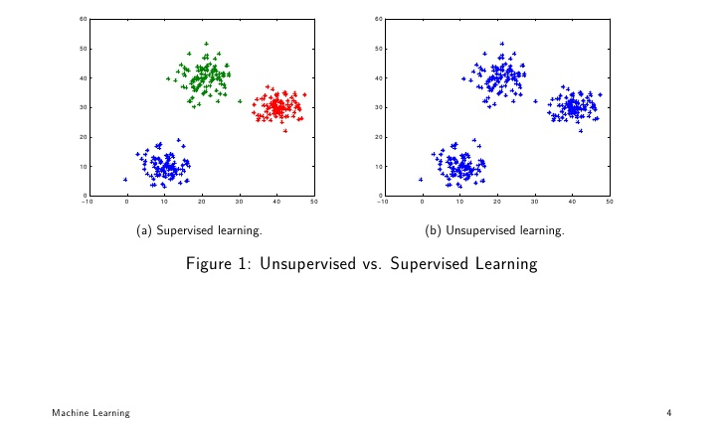
Supervised vs Unsupervised Learning

Slide 15
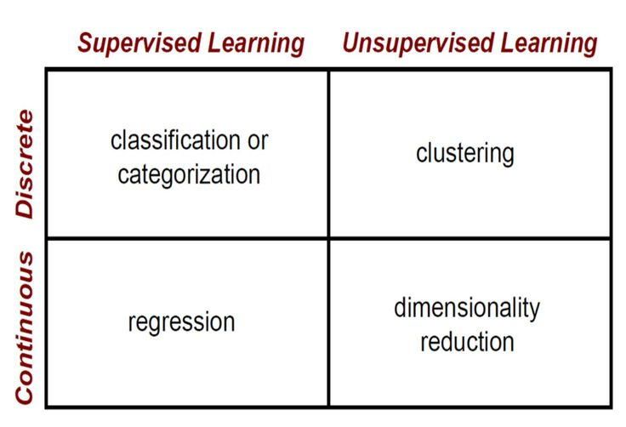
Supervised vs Unsupervised Learning

Slide 16
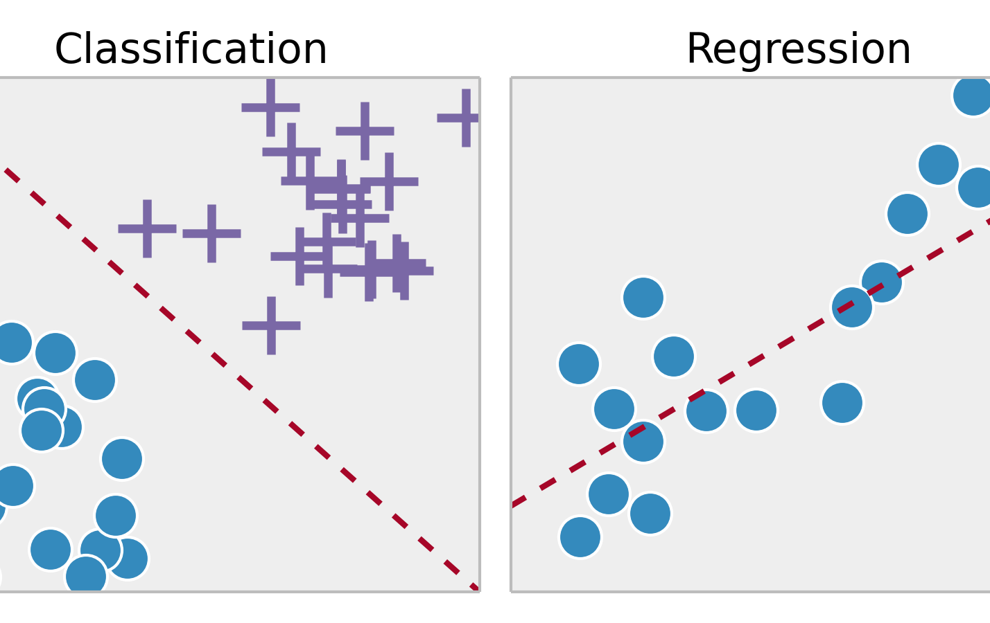
Supervised Learning – Classification vs Regression

Slide 17
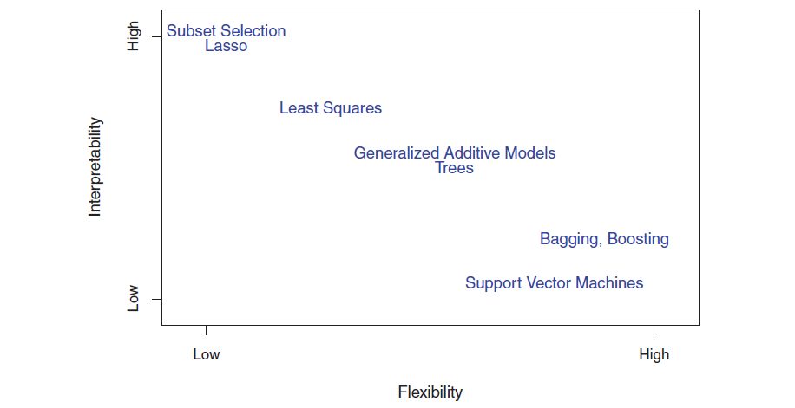
Flexibility vs Interpretability

Slide 18
Why data types matter?
Different data types have different limitations and strengths.
Certain types of analyses aren’t possible with certain data types.
There are 3 types of data which we may might use for analysis:
1. Time series data: Time-Series data are data on one variable collected at a single point in time, e.g.
2. Cross-sectional data: Cross-sectional data are data on one or more variables collected at a single point in time, e.g.
3. Panel data, a combination of 1. & 2.

Slide 19
Cross-Section or Time Series?
You would like to find the the relationship between company size and the return to investing in its shares. You survey different company sizes and their corresponding returns. What type of data did you collect?
You would like to discover how the value of Apple’s stock price has varied when it announced the value of its dividend payment. What type of data will you collect to answer this question?

Slide 20
PARSE: UNDERSTANDING YOUR DATA
You need to understand what you’re working with.
To better understand your data
Create or review the data dictionary
Perform exploratory surface analysis
Describe data structure and information being collected
Explore variables and data types

Slide 21
INTRO TO DATA DICTIONARIES AND DOCUMENTATION
Data dictionaries help judge the quality of the data.
They also help understand how it’s coded.
Does gender = 1 mean female or male?
Is the currency dollars or euros?
Data dictionaries help identify any requirements, assumptions, and constraints of the data.
They make it easier to share data.

Slide 22
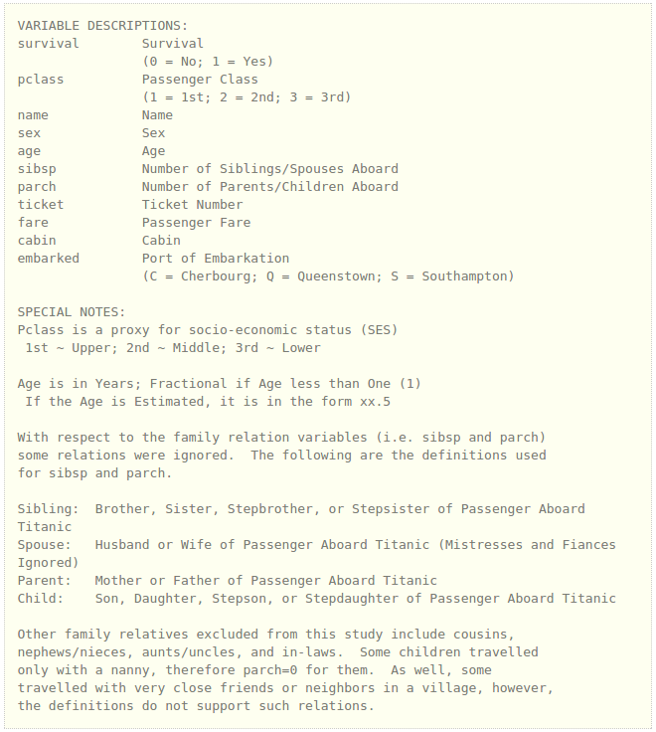
DATA DICTIONARY EXAMPLE: KAGGLE TITANIC DATA

Slide 23
NUMPY AND PANDAS INTRO

Slide 24
NUMPY AND PANDAS INTRO
What are Numpy and Pandas? Python packages
Pandas is built on Numpy.
Numpy uses arrays to do basic math and slice and index data.
Pandas uses a data structure called a Dataframe.
Dataframes are similar to Excel tables; they contain rows and columns.
Notes:
- note that this methodology is probably the most standardized but is falling out of fashion, especially with smaller companies

Slide 25
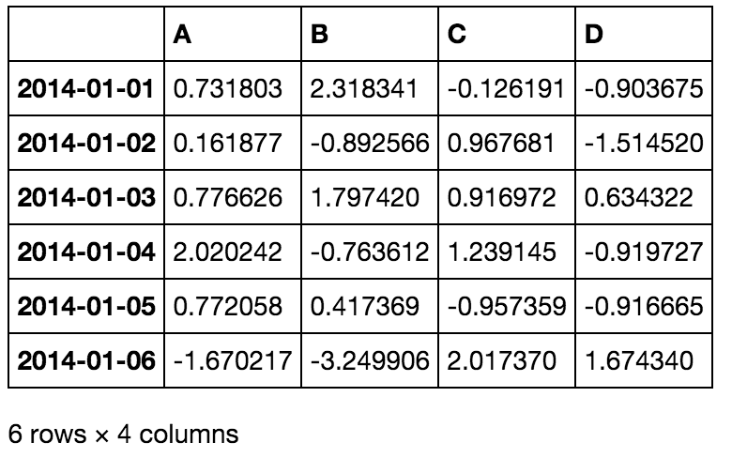
NUMPY AND PANDAS INTRO
Notes:
- note that this methodology is probably the most standardized but is falling out of fashion, especially with smaller companies

Slide 26
NUMPY AND PANDAS INTRO
With these packages, you can select pieces of data, do basic operations, calculate summary statistics.
Follow along and code along as we learn about Numpy and Pandas.
Notes:
- note that this methodology is probably the most standardized but is falling out of fashion, especially with smaller companies

